Slide 1
Csci 380 Project
11932981 7/6/2023

Slide 2
Requirments
Introduction: a brief and clear description of the project - Problem statement - Objectives or purpose or goals of the system or solutions -Scope : Milestones / deliverables / Estimated timeline / Estimated budget /constraints -Stakeholders and their roles - A list of Requirements (Functional and Non-functional (Hardware and software))

Slide 3
Phase 1
0-Background on the concept:
Back at the begging of the pandemic in 2020, I was in a disheveled state where my mental stability and productivity were in a state of catatonic shock. I remember seeking much help and doing research of productivity and building fortitude. Among the methods that proved useful at the time was this app called fabulous which I stuck with for the good amount of 5 months and was able to adequately guide me during that process. A link to their website: https://www.thefabulous.co/

Slide 4
1-Introduction:
The application helped with some stuff but lacked longevity; I will reference this part again further down in the system of solutions. On the other hand there was this other productivity app that turned your to do list to a game with health and stamina and rewards. It was clearly a passion project that lacked budget and design but the concept was very fun and engaging, however it was not efficient for productivity unlike fabulous. Another problem with both applications was that they were solely for mobile (not cross platform) and fabulous was only available via webpage to access from your computer (which is where most productivity takes place).
2-So here our problem arises:
How do we develop a cross platform Application that is both efficient but also engaging enough not to lose longevity?

Slide 5
3- Objectives or purpose or goals of the system or solutions:
Problem scope:(Objective)
Development for: ( IOS, Android, Windows, Mac)
Ease of use(How to minimize the efforts of the user)
Longevity( How to Gamify the person’s tasks and make the app more fun)
Integration with individual(how to make it a habit of opening the app daily)
Marketing( how to get the users hooked to the product
Profit( one price, or free but premium with subscription)
Design(How to package the app to gain a wide scope influence)

Slide 6
Solution Scope:(System of Solutions)
😭 Hire 3 Senior Development leaders (Mac & IOS) (Android)(Windows) and hire extra junior developers based on each team leaders needs and within budget
😭 Establish a voice assistant like Alexa or Siri that allows the user to talk to the app rather than having to use it(Also helps in the engagement aspect)
😭 Lay a system of rewards and punishments ( for example the app can automatically add a task of “eat dessert” or “watch a movie” if the user finished 5 critical tasks, and maybe we can have the personal assistant programmed to show sadness or anger when the user is not finishing the tasks(working idea)
😭 Provide a way for the user to link the app with google calendar( Where most people put their main schedule, and establish a routine ( usually twice a day , morning and evening ) where there is the task of writing and checking your to do list.
😭 Make a plan of a free month premium and 2 additional at a discount and the idea is that after 3 months of using the app with it’s unlimited features the users will feel it is an essential part of their life
😭 Establish a monthly , yearly, or lifetime subscription. At a low rate like Netflix subscription and since there is the idea of community ( More about this in the stakeholder part) quantity is key. Side note: Part of the success of fabulous is that they had these community forums for different goals and aspirations and people could interact and share their achievements which created the butterfly effect of more people getting invested.

Slide 7
4-Full Scope:
N.B.: Here is where the actual development will take process, I will assign Alphabetical ordering for these tasks so that they will be clear in the time table, also since I only have experience in SQL, java , game, and web development (also visual programing) I will be approaching this as being developed for windows solely but in reality for this Project to work it has to be cross platform.
Mile Stones & Deliverables:
Step A: 1 weeks Prerequisites: none
Interview Candidate and select the best ones for the following positions:
3 Lead developers ( The afore mentioned platforms)1 lead web developer, 1 database developer, 1 Lead designer and the rest of the team based on the development needs. As well as a Marketing and Research Leader.
Step B: 2 week Prerequisites: none
Research productivity and health plans as well as seeking council from professional doctors, phycologists, and life coaches about the correlation between work and mental health and how to guide someone towards becoming their better self.
Step C: 2 weeks Prerequisites: A
Set up a website that allows users to register and preorder the application and paten the app Idea and domain name.

Slide 8
Step D: 1 week Prerequisites: A,B
Establish social media accounts and have the marketing team share development process, launch the project description on GoFundMe , Patreon , and other project support platforms
Step E: 1 week Prerequisites: C,D
Discuss basic features, themes, and plan several strategies of approach. Then survey the followers on social media about different themes and functionalities and based on the feedback and the initial strategies finalize a development plan and establish a time line N.B. : for this project I’m going to assume that we already got feedback and the ideas I have were approved by the management and survey results.
Step F: 2 weeks Prerequisites: C,D
Update website to match the design agreed upon for the application and develop the GUIs with no functionality with the same design across the 4 operating systems.
App Development Start.
Step G: Create GUIs with no functionality 1 week Prerequisites: E
Basic features include:
Home Page: (Designed like a desk with different spaces to access the app’s functions)
To do list Page, Calendar Page, Diary Page, Community Page, + brief description and hyperlinks to the website with more information

Slide 9
Step H: Program basic Functions 3 weeks Prerequisites: G
Add, remove, update. Plus priority by color (red important task, green rest, blue health, orange studying… etc etc) plus intractable buttons
Step I: Further Programing 3 weeks Prerequisites: H
Reminder system, reward & punishment system ( Will also be integrated with assistant system later) and task suggestions such as the routines discussed in the solution scope.
Step J : More Programming 5 weeks Prerequisites:G
Develop journeys, which are plan guides for different goals and link with reward system, create function for allowing the users to share results with the community page and forums later on.
Journeys include: Fitness & Bodybuilding , Studying & Research , Cooking & Health , Home maintenance, Budget Planning, Leisure Bucket, Self Actualization. ( All made based on the research in step A) The last page will be locked and the user can unlock it and start that journey when the application reaches a certain number of reward points (There are a lot more details and specifics to add here, but the main point is that this step will take a long time)
Step K: Even More Programing! 3 weeks Prerequisites: J
Buy the rights to use google voice recognition software or Android’s Bixby, or any similar good software and develop the responses , voice commands, reward and punish behavior, and journey guidance responses for the virtual assistant, and personalized preference options.
Step L: The Programing Never Stops 2 weeks Prerequisites: J
Set up a database on the company server for the journey community, implement certain ranks based on reward points from journey and link it to the database. Allow Users to create custom communities, followings, and share them as well as the app base communities.

Slide 10
Step M: Kill me now and end this suffering. 2 weeks Prerequisites : L
Finalize the development Process, Connect all created methods and assets through a master class as well as creating several interface classes and array classes for handling the database. Run Alpha Testing and release(get feedback on glitches and areas of improvement from other developers and experts)
Step N: Debugging 1 week Prerequisites: M
Even with the optimistic timeline and plan, it is unrealistic for the app not to encounter runtime and other errors so this step will be necessary albeit the time scale will be different depending on the optimistic and pessimistic calculations.
Step O: Beta Testing & Release 1 week Prerequisites: N
Authenticate payment methods and plan providers (Verified app) then launch the app on the website, playstore,android store, apple store, and Microsoft store. (any other valid places im not aware off).Let the Marketing team run the ad campaign.
N.B. I will only provide an optimistic take on both budget and time since I don’t know how much they will really cost on both ends.
Estimated Budget:14,000$ Calculated below
Estimated Timeline: 16 weeks , 4 Months(Optimistic)
Week1 | Week2 | Week3 | Week4 | Week5 | Week6 | Week7 | Week8 | Week9 | Week 10
A,B | B,C | C,D | E,F | F,G | H, J | H,J | H,J | I, J, | I J,
Week11 | Week12 | Week13 | Week14 | Week15 | Week16
I,K,L | K,L | K,M | M | N | O

Slide 11
Constraints:
1-Finding the right qualifications
2- delivering the same results across all operating software.
3-The app has no way of forcing the individual to be productive and create urgency
4- The app is not automated enough to be useful for individuals with an already busy schedule
5- The app lacks accountability and drive, unlike a game where there is an end goal that you can only reach by playing, the only similar thing we have is the secret journey which the user can basically lie to get to
Stakeholder and their roles:
1-Company that owns this app: role of maintaining updating and engaging with the app community to maintain it and constantly improve it building sustainable revenue in return.
2-Average User: The normal person can adhere to this app no matter what the profession, parents, teachers, programmers anyone really can use it to better manage their time and schedule.
3-Therapists &/or Life Coaches: They promote this app to their clients and even use it as a review tool for their client’s well being. .
It would be a good idea to hire some of these professionals to manage they journey communities and this will provide more accountability, engagement and purpose, also a sense of individuality as the app will be the perfect medium between them and the professionals.( Provide extra service fee for individuals who want to hire therapists or life coaches) . This incentivizes the coaches to get more people to sign up to the app to increase their personal revenue since it will be proportional to their subscribers)

Slide 12
List of Requirments:
Hardware:
1-Company Server. Computer with large Storage and 24/7 power & wifi to act as a server.(1000$)
2-Company Computers: Used for development, fast processors and large ram required. Around 7 one for each of the different team leader.(500/lead 3500$)
3- Router and Switch: Used to set up fast internet connection in addition to Lan connection(1000$ including power and internet for project)
Software: Assume onetime purchase for 200$/app(Some are free to use)
1-JDK development kit(this is for windows, other operating systems will need other software)Free
2-Api for voice recognition and talk: (Google is a good choice)200$
3.SQL development kit(for the database)Free
4.Eclipse and Microsoft visual studio(My personal choices) they provide the ability of programing of: Swing ,NodeJs,JavaScript,Php and other languages (for webdevelopent and for app development)200 subscription for premium feature
5. Server manager and lan manager: Since there will be two main servers one for work and another for customers it would be a good idea to buy an already existing app that can manage both instead of spending time creating it.200$
6.Adobe illustrator plus other tools: for visual design 200$

Slide 13
Additional expenses:
Marketing Leader + team: 1000$
Design Leader + team : 1000$
Windows development Leader+ team: 2000$
Web development Leader+ team: 1000$
The teams below have lower budget since their job is to convert the application to the other platforms and most of the ground work was already built for them.
Mobile development Leader + team: 1000$
IOS and Mac development Leader + team: 1000$

Slide 14
Phase 2.
Use Case 1: Application is “One time purchase”, Company hires Life Coaches.
Actors:
1- User.
2- Life Coaches
3- Tech Support
4- Community Moderator
Use Case 2: Application is “Subscription based” , premium users may become life coaches and edit communities if they meet certain requirements:
Actors:
Common User
Premium User
Life Coach Candidate
Community Moderator
Tech Support
Use Case 3 : Application is free to use and ads run on community pages
Same actors as before in addition to ad managers (this use case is just for diversity) (not Optimal)
The first 2 use cases are the ones under study.

Slide 15
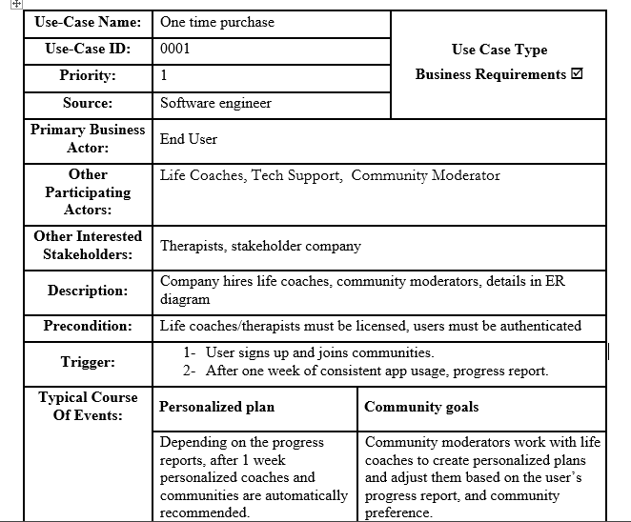

Slide 16
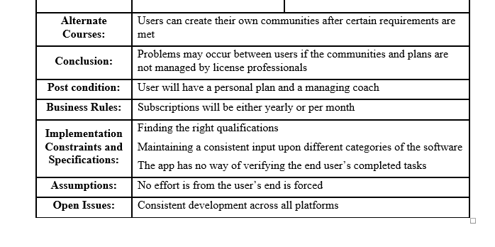

Slide 17
1-Use Case Diagram
2- ERD
3-DFD

